Slide 1


SIMATS ENGINEERING Saveetha Institute of Medical and Technical Sciences Chennai-602105.
Big Data Analytics Platform for Intelligent Public Transportation Planning and Passenger Demand Forecasting
Presented By:
A.Reddy Prasad (192472045)
P.Poorna Chandra (192472287)
P.krishna Sashank (192525191)
N.Sudheer (192525087)
Supervised By:
BOOMIJA M D

Slide 2
Abstract
Public transportation generates large amounts of data from GPS, ticketing systems, passenger records, and vehicles.
Managing and analyzing this large data is difficult using traditional methods.
The proposed system uses Big Data Analytics to process transportation data efficiently.
Machine Learning is used to predict future passenger demand.
The system identifies peak hours, travel patterns, and high-demand areas.
Route Analytics helps analyze route performance and improve route planning.
The Dashboard Module displays demand, routes, and transportation information using charts and graphs.

Slide 3
Introduction
Public transportation is one of the most important services for daily travel.
Thousands of passengers use buses, trains, and other public transport every day.
The number of passengers changes during peak hours, weekends, holidays, and special events.
Big Data Analytics collects and processes large amounts of transportation data from GPS, ticketing systems, and passenger records.
Machine Learning analyzes past travel patterns and predicts future passenger demand.
Accurate demand forecasting helps transport authorities plan better routes and schedules.

Slide 4
Problem Statement
Public transportation systems generate large amounts of data from passengers, GPS, ticketing systems, and vehicles.
This data is often stored separately and is difficult to analyze effectively.
Traditional transportation planning methods may not accurately predict future passenger demand.
Poor demand prediction can lead to overcrowded buses, unused vehicles, and long waiting times.
Inefficient route planning can increase travel time, fuel consumption, and operational costs.
Transport authorities need real-time information to make quick and accurate decisions.

Slide 5

OBJECTIVES
To collect and analyze public transportation data from different sources.
To predict passenger demand using Machine Learning techniques.
To identify peak and off-peak travel hours.
To optimize bus routes and transportation schedules.
To improve the utilization of buses and other transport resources.
To reduce passenger waiting time and traffic congestion.

Slide 6


LITERATURE REVIEW
S.No | Research Paper | Author | Advantages | Journal | Technologies Used
1 | ML for Public Transport | Alexandre et al., 2023 | Improves demand prediction. | Transportation Research Record | Machine Learning
2 | Public Transport Demand Prediction | Zhong et al., 2023 | Predicts passenger demand. | Communications in Transportation Research | PCA, Data Analytics
3 | Urban Transport Travel-Time Prediction | Zhang et al., 2022 | Improves travel planning. | PLOS ONE | GPS, Data Analytics
4 | Smart Card Demand Forecasting | Caroleo et al., 2023 | Supports demand forecasting. | Intelligent Transport Systems | Smart Cards, ML

Slide 7
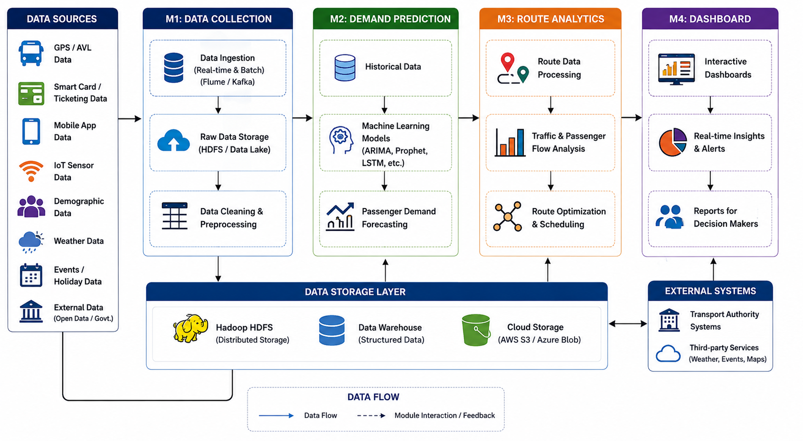
ARCHITECTURE DIAGRAM

Slide 8
Module 1:Data Collection
Collect transportation data from different sources.
Gather GPS, ticketing, and passenger travel data.
Collect real-time and historical transportation data.
Clean and preprocess the collected data.
Remove duplicate and missing values.
Input: GPS Data, Ticketing Data, Passenger Records.
Output: Clean and organized dataset ready for analysis.

Slide 9
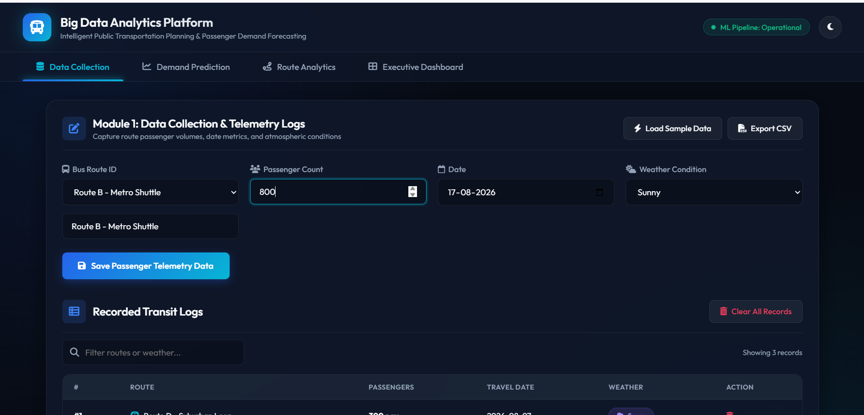
Implementation

Slide 10
Module 2: Demand Prediction
Analyze historical passenger travel data.
Collect daily, weekly, and monthly travel records.
Identify passenger travel patterns and trends.
Detect peak hours and off-peak hours.
Use Machine Learning algorithms for prediction.
Input: Historical Passenger Data, Travel Records, Ticketing Data
Output: Passenger Demand Forecast Report

Slide 11
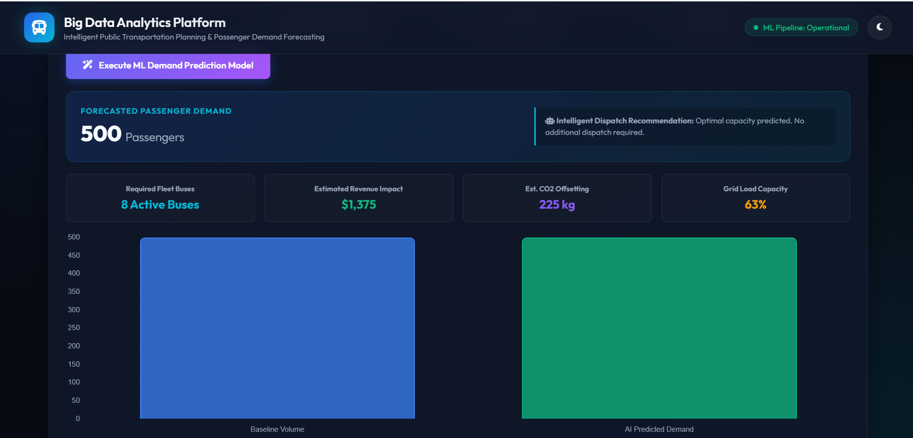
Implementation

Slide 12
Module 3: Route Analytics
Analyze bus routes and transportation networks.
Monitor traffic conditions using GPS data.
Measure route efficiency and travel time.
Identify high-traffic and congestion areas.
Compare different routes for better performance.
Suggest the shortest and fastest routes.
Input: GPS Data, Route Information, Traffic Data
Output: Optimized Routes and Route Performance Report

Slide 13
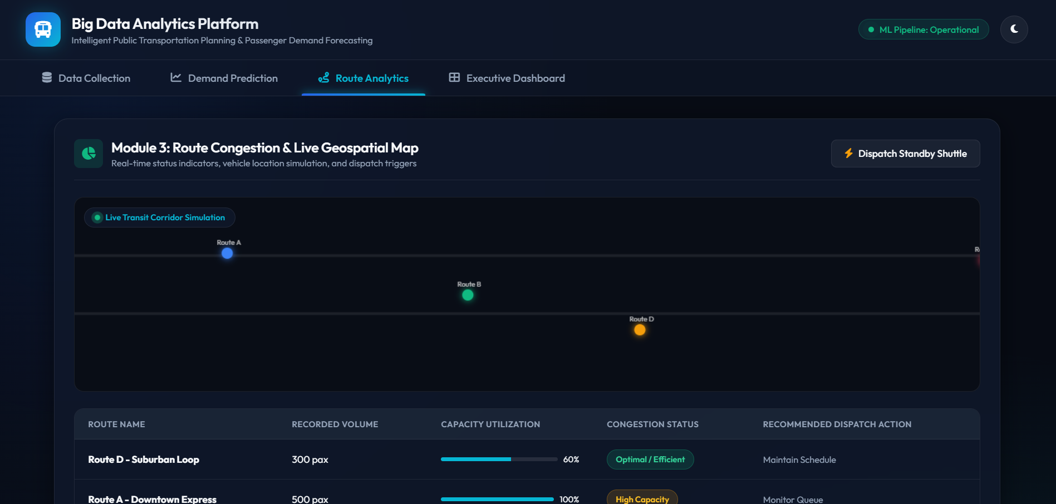
Implementation

Slide 14
Module 4: Dashboard
Display transportation data in a user-friendly interface.
Show passenger demand prediction results.
Present route analysis using charts and graphs.
Monitor transportation performance in real time.
Generate reports for transport authorities.
Display key performance indicators (KPIs).
Input: Prediction Results, Route Analytics Data, Transportation Reports
Output: Interactive Dashboard, Reports, Charts, and Performance Analytics

Slide 15
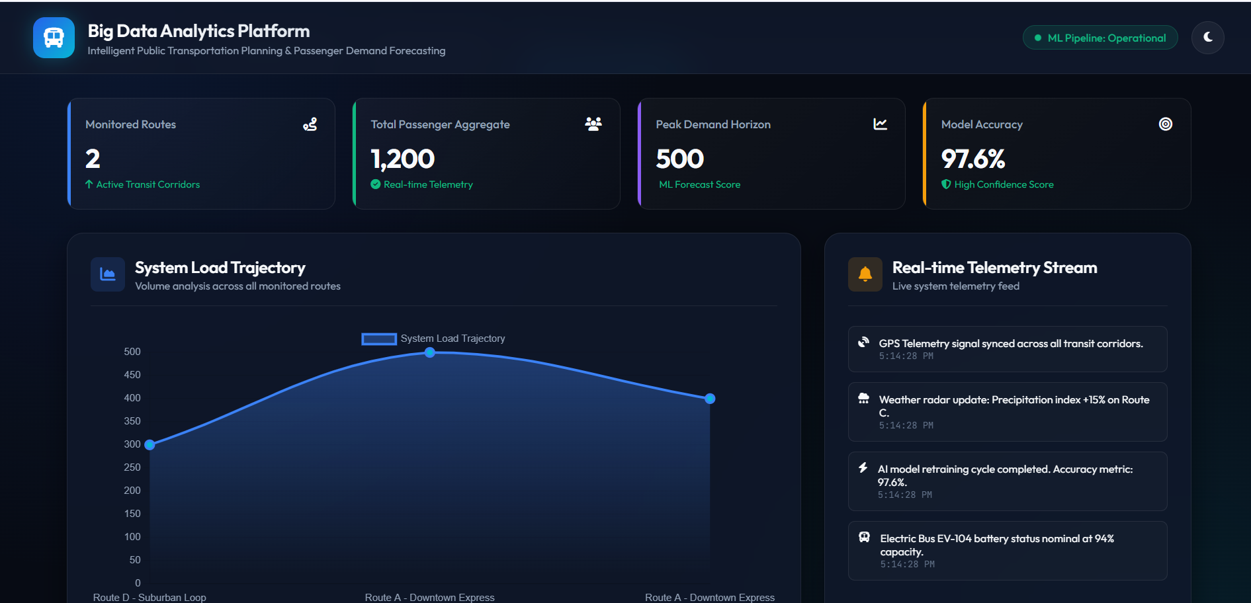
Implementation

Slide 16
Applications
The proposed platform can be used by government transport departments to analyze overall public transportation performance.
It can help transport authorities understand where, when, and how many passengers use public transportation.
The system can predict daily, weekly, monthly, and seasonal passenger demand.
It can help identify peak travel periods such as morning and evening rush hours.
Based on predicted demand, additional buses can be assigned to high-demand routes.
It can support automatic or data-based bus timetable planning.

Slide 17
Conclusion
This project uses Big Data Analytics to improve public transportation planning.
It collects and analyzes transportation data from different sources.
Machine Learning helps predict future passenger demand accurately.
Route analytics identifies the best routes and reduces traffic congestion.
The dashboard provides real-time reports and visual insights for decision-making.
It supports smart city development through data-driven transportation management.

Slide 18


Future Scope
Integrate real-time GPS and IoT data for continuous transportation monitoring.
Improve passenger demand prediction using advanced Deep Learning models.
Add weather, traffic, holidays, and special-event data for more accurate forecasting.
Develop dynamic route optimization based on real-time traffic and passenger demand.
Implement real-time bus scheduling based on predicted passenger volume.
Add a mobile application for passengers to view routes, timings, and bus locations.
Provide personalized travel recommendations based on passenger requirements.

Slide 19
References
Wan, L. (2024). Optimizing metro passenger flow prediction: Integrating machine learning and time-series analysis with multimodal data fusion. IET Circuits, Devices & Systems.
Zhang, X., Lauber, L., Liu, H., Shi, J., Xie, M., & Pan, Y. (2022). Travel time prediction of urban public transportation based on detection of single routes. PLOS ONE, 17(1).
Ma, Y. (2022). Optimization algorithm of urban rail transit network route planning using deep learning technology. Computational Intelligence and Neuroscience.
Tiwari, S., et al. (2022). A data-driven system for cooperative-bus route planning based on generative adversarial network and metric learning. Annals of Operations Research.
Shi, et al. (2023). Online prediction of network-level public transport demand based on principal component analysis. Communications in Transportation Research, 3, 100093.

Slide 20


